Slide 1
PPT ON Face, Age and Gender Detection

Slide 2
Description of the Project
In this python project, we implemented a CNN to detect gender and age from a single picture of a face.
To make machines more intelligent, the developers are diving into machine learning and deep learning techniques. A human learns to perform a task by practicing and repeating it again and again so that it memorizes how to perform the tasks. Then the neurons in his brain automatically trigger and they can quickly perform the task they have learned. Deep learning is also very similar to this. It uses different types of neural network architectures for different types of problems.
For example – object recognition, image and object detection, image segmentation, etc.

Slide 3
CNN(Convolution Neural Network)
A Convolutional Neural Network or CNN is a Deep Learning Algorithm which is very effective in handling image classification tasks. It can capture the Temporal and Spatial dependencies in an image with the help of filters or kernels.
A Convolutional Neural Network (ConvNet/CNN) is a Deep Learning algorithm which can take in an input image, assign importance (learnable weights and biases) to various aspects/objects in the image and be able to differentiate one from the other. The pre-processing required in a ConvNet is much lower as compared to other classification algorithms.

Slide 4
Hardware and Software Requirements
Sr. No. | Requirements | Type | Requirement Description
1. | Hardware Requirements | Processer | i3 or above with a Supported GPU
 |  | RAM | 8 GB RAM
 |  | Hard Disk space | 100 GB Free disk spaces
2. | Software Requirements | Operating System | Windows 10/ Windows server 2012
 |  | Prerequisite | Python (3+), Keras, Annaconda and supporting Libraries
 |  | Other | Administrator & internet access is required in the windows machine, it should be open environment.
 |  | Application access | VPN access (If required), Portal access, Application access, shared point access, SMTP port & credentials.
 |  | Browser | Google chrome, for JupyterNotebook

Slide 5
Technology and Dataset Used
Technology Used :(Deep Learning)
Deep learning is an artificial intelligence (AI) function that imitates the workings of the human brain in processing data and creating patterns for use in decision making. Deep learning is a subset of machine learning in artificial intelligence that has networks capable of learning unsupervised from data that is unstructured or unlabelled. Also known as deep neural learning or deep neural network.
Deep learning has evolved hand-in-hand with the digital era, which has brought about an explosion of data in all forms and from every region of the world. This data, known simply as big data, is drawn from sources like social media, internet search engines, e-commerce platforms, and online cinemas, among others. This enormous amount of data is readily accessible and can be shared through fintech applications like cloud computing.

Slide 6
Dataset:
For this python project, we’ll use the Adience dataset; the dataset is available in the public domain. This dataset serves as a benchmark for face photos and is inclusive of various real-world imaging conditions like noise, lighting, pose, and appearance. The images have been collected from Flickr albums and distributed under the Creative Commons (CC) license. It has a total of 26,580 photos of 2,284 subjects in eight age ranges (as mentioned above) and is about 1GB in size. The models we will use have been trained on this dataset.

Slide 7

Essential Libraries and Tools Used
Tools:
PyCharm: PyCharm is an integrated development environment (IDE) used in computer programming, specifically for the Python language. It is developed by the Czech company JetBrains. It provides code analysis, a graphical debugger, an integrated unit tester, integration with version control systems (VCSes), and supportsweb development
with Django as well as data science
with Anaconda.
PyCharm is cross-platform,with Windows,
macOS and Linux versions. The Community Edition is released under the Apache License,and there is also Professional Edition with extra features – released under a proprietary license.

Slide 8
Libraries
Math Library:
The Python Math Library provides us access to some common math functions and constants in Python, which we can use throughout our code for more complex mathematical computations. The library is a built-in Python module, therefore you don't have to do any installation to use it. In this article, we will be showing example usage of the Python Math Library's most commonly used functions and constants.
This module provides access to the mathematical functions defined by the C standard.
These functions cannot be used with complex numbers; use the functions of the same name from the cmath module if you require support for complex numbers.
Receiving an exception instead of a complex result allows earlier detection of the unexpected complex number used as a parameter, so that the programmer can determine how and why it was generated in the first place.

Slide 9
Libraries
Argparse :
The argparse module makes it easy to write user-friendly command-line interfaces. The program defines what arguments it requires, and argparse will figure out how to parse those out of sys.argv The argparse module also automatically generates help and usage messages and issues errors when users give the program invalid arguments.
.ArgumentParser(prog=None, usage=None, description=None, epilog=None, parents=[], formatter_class=argparse.HelpFormatter, prefix_chars='-', fromfile_prefix_chars=None, argument_default=None, conflict_handler='error', add_help=True, allow_abbrev=True, exit_on_error=True)
Create a new ArgumentParser object. All parameters should be passed as keyword arguments.

Slide 10
Libraries
Numpy:
NumPy is a Python package. It stands for 'Numerical Python'. It is a library consisting of multidimensional array objects and a collection of routines for processing of array.
Numeric, the ancestor of NumPy, was developed by Jim Hugunin. Another package Numarray was also developed, having some additional functionalities. In 2005, Travis Oliphant created NumPy package by incorporating the features of Numarray into Numeric package. There are many contributors to this open source project.

Slide 11
Operations using NumPy:
Using NumPy, a developer can perform the following operations −
Mathematical and logical operations on arrays.
Fourier transforms and routines for shape manipulation.
Operations related to linear algebra.
NumPy has in-built functions for linear algebra and random number generation.

Slide 12
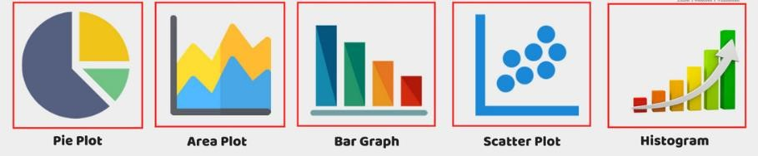
Libraries
. Matplot: Matplot library is a python library used to create 2D graphs and plots by using python scripts. It has a module named pyplot which makes things easy for plotting by providing feature to control line styles, font properties, formatting axes etc. It supports a very wide variety of graphs and plots namely - histogram, bar charts, power spectra, error charts etc. It is used along with NumPy to provide an environment that is an effective open source alternative for MatLab. It can also be used with graphics toolkits like PyQt and wxPython.
Types of Plots:
There are various plots which can be created using python matplotlib.
Some of them are listed below:

Slide 13
Libraries
Pandas:
Pandas is an opensource Python package that is most widely used for data science/data analysis and machine learning tasks. It is built on top of another package named Numpy, which provides support for multi-dimensional arrays. As one of the most popular data wrangling packages, Pandas works well with many other data science modules inside the Python ecosystem, and is typically included in every Python distribution, from those that come with your operating system to commercial vendor distributions like Active State’s ActivePython.

Slide 14
Working flow of the project
1. Import the libraries and load the dataset
First, we are going to import all the modules that we are going to need for training our model. The Keras library already contains some datasets and MNIST is one of them. So we can easily import the dataset and start working with it. The mnist.load_data() method returns us the training data, its labels and also the testing data and its labels.

Slide 15
Working flow of the project
2. Preprocess the data
The image data cannot be fed directly into the model so we need to perform some operations and process the data to make it ready for our neural network. The dimension of the training data is (60000,28,28). The CNN model will require one more dimension so we reshape the matrix to shape (60000,28,28,1).
3. Create the model
In the part we’ll learn about age detection, including the steps required to automatically predict the age of a person from an image or a video stream (and why age detection is best treated as a classification problem rather than a regression problem).
From there, we’ll discuss our deep learning-based age detection model and then learn how to use the model for both: (1) Age detection in static images
(2) .Age detection in real-time video streams

Slide 16
Working flow of the project
4. Train the model
Once your face detector has produced the bounding box coordinates of the face in the image/video stream, you can move on to Stage #2 — identifying the age of the person.
5. Evaluate the model
Age detection is the process of automatically discerning the age of a person solely from a photo of their face.
Typically, you’ll see age detection implemented as a two-stage process:
Stage #1: Detect faces in the input image/video stream
Stage #2: Extract the face Region of Interest (ROI), and apply the age detector algorithm to predict the age of the person

Slide 17
Working flow of the project
6. Running real time embedded system
For Stage #1, any face detector capable of producing bounding boxes for faces in an image can be used, including but not limited to Haar cascades, HOG + Linear SVM, Single Shot Detectors (SSDs), etc.
Exactly which face detector you use depends on your project:
Haar cascades will be very fast and capable of running in real-time on embedded devices — the problem is that they are less accurate and highly prone to false-positive detections
When choosing a face detector for your application, take the time to consider your project requirements — is speed or accuracy more important for your use case? I also recommend running a few experiments with each of the face detectors so you can let the empirical results guide your decisions.

Slide 18
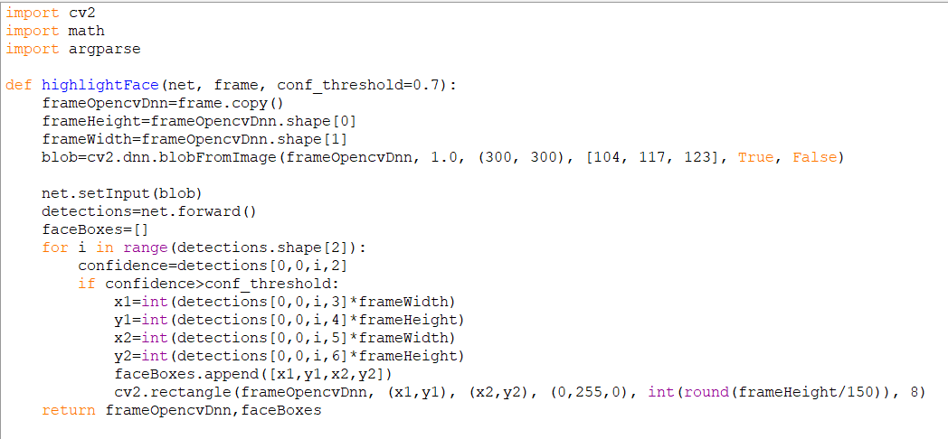
Project Coding

Slide 19
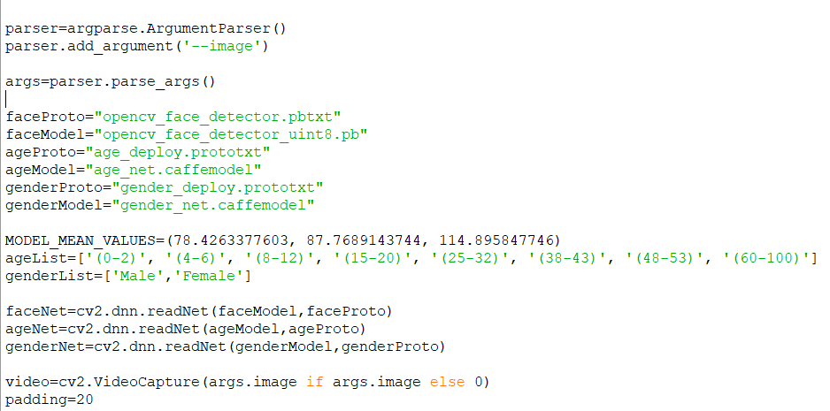

Slide 20
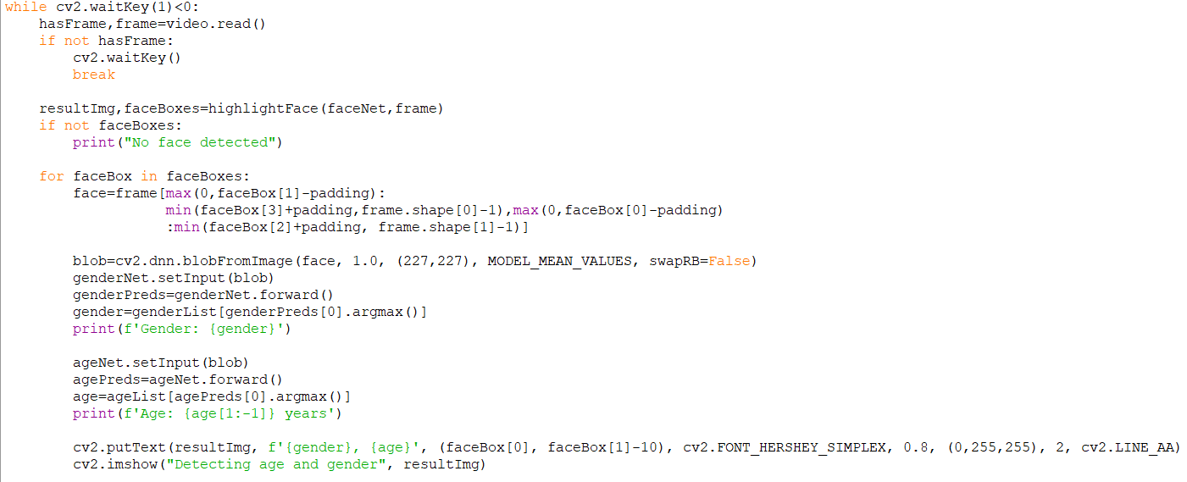

Slide 21
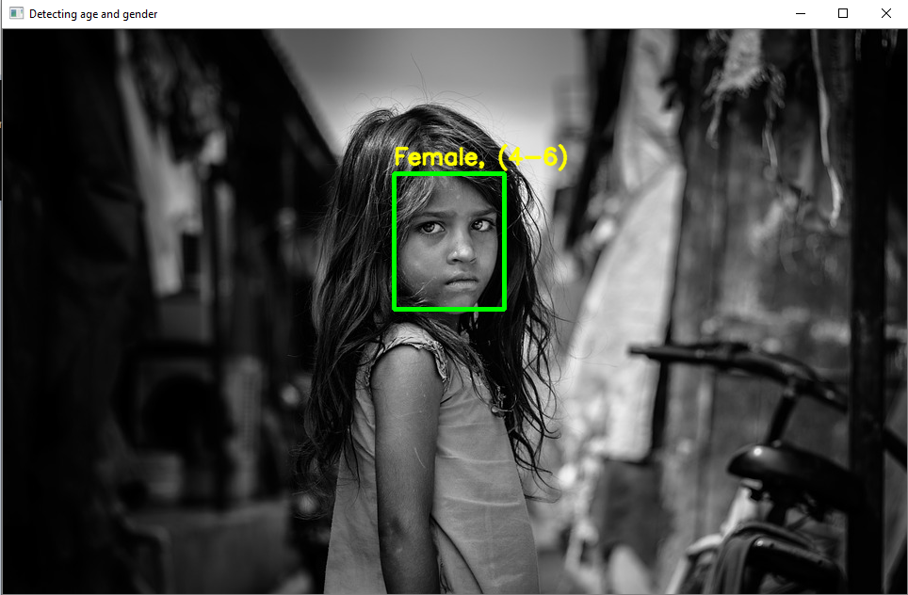
Output Screenshort

Slide 22
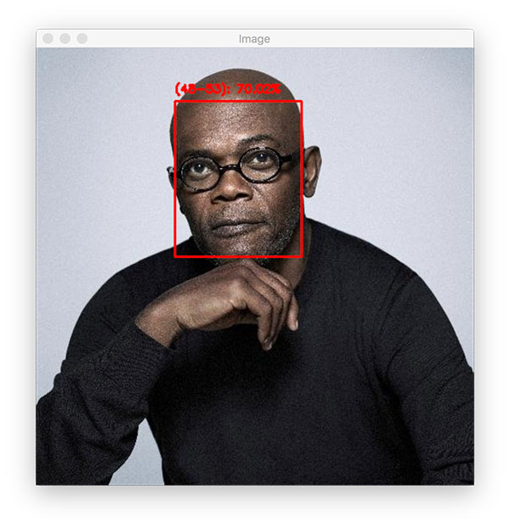

Slide 23
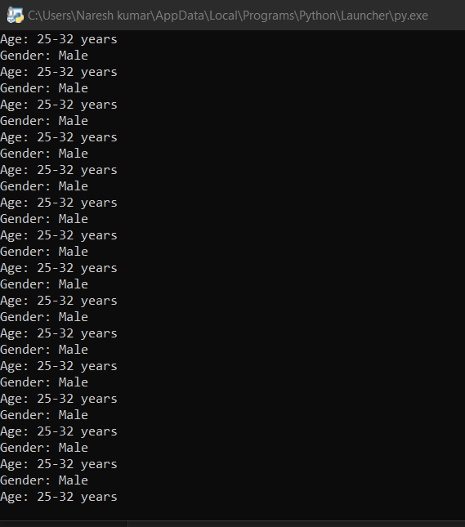

Slide 24
Summary
There are a number of factors that determine how old a person visually appears, including their lifestyle, work/job, smoking habits, and most importantly, genetics. Secondly, keep in mind that people purposely try to hide their age — if a human struggles to accurately predict someone’s age, then surely a machine learning model will struggle as well.
Therefore, you must assess all age prediction results in terms of perceived age rather than actual age. Keep this in mind when implementing age detection into your own computer vision projects.

Slide 25
FUTURE SCOPE
The Face Recognition (FR) is growing as a major research area because of the broad choice of applications in the fields of commercial and law enforcement. Traditional FR methods based on Visible Spectrum (VS) are facing challenges like object illumination, pose variation, expression changes, and facial disguises. Unfortunately these limitations decrease the performance in object identification and verification.
To overcome all these limitations, the Infrared Spectrum (IRS) may be used in human FR. So it leads and encourages the researchers for continuous research in this area of FR. Simultaneously, the present study emphasizes the use of three dimensional cubic dataset i.e. Multi/ Hyperspectral Imagery Data in FR. The IR based Multi/ Hyperspectral Imaging System can minimize the several limitations arise in the existing and classical FR system because the skin spectra derived with cubic dataset depicts the unique features for an individual

